Slide 1

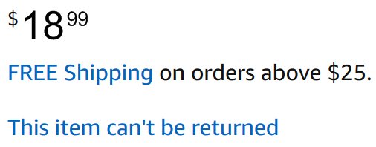
1. Filtering on brand and price (internal)
Already discussed to replace the images with text inserts for two of the elements:
name-review (current image example below)
price-other-info (current image example below)
All the required inputs for these two images will be provided inside the standard input document provided to IIS:
Product name (ZeroSweat.. above)
Product price ($18.99 above, already provided) – will be used for the filtering option, please check down in the PPT
Brand (the blue ZeroSweat above) – will be used for the filtering option, please check down in the PPT
Number of stars – integers only (1,2,3,4,5), to be displayed for each product. I suggest using UTF symbols black star (turned yellow with yellow/grey border) and white star (with yellow/grey border)
Number of customer reviews (1,456 customer reviews above) – integers only
Additional information below the price (FREE Shipping… above) – which can be just plain text
That would leave us with RE only providing the product images to be displayed + the big from the manufacturer information. But we cannot use text there, as it often features custom design for the different brands.

Slide 2
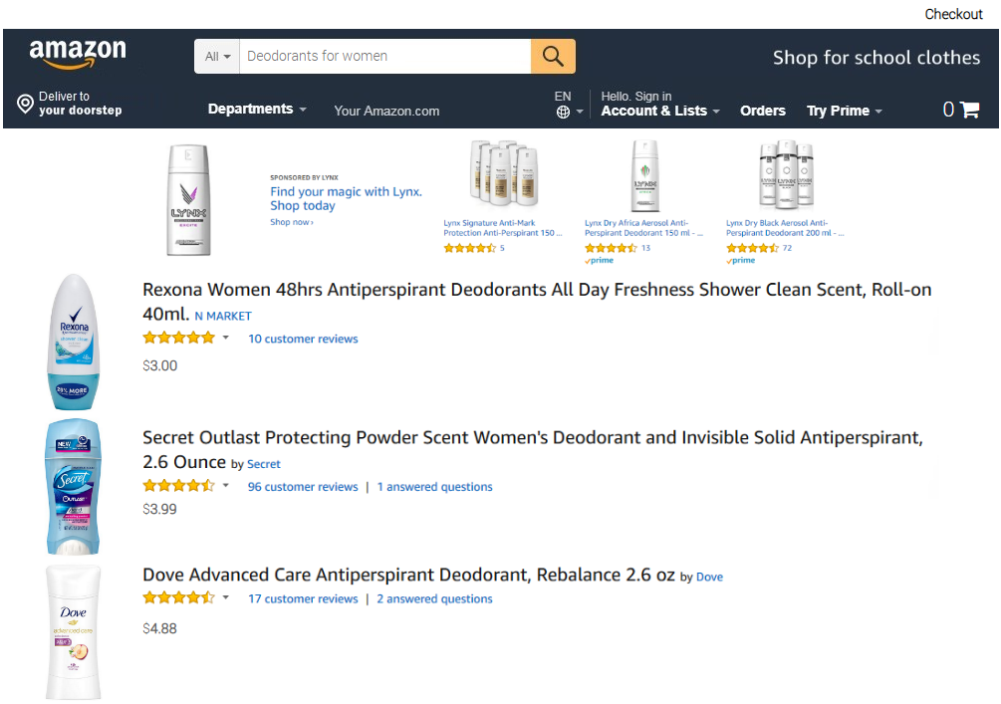
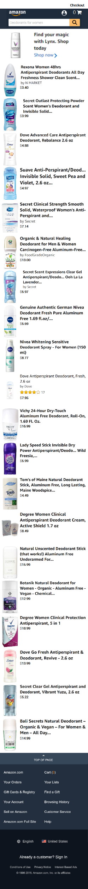
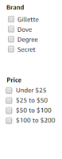
2. Filtering on brand and price (high chance this being requested)
Filtering on brand and price will support up to 10 multi-answer positions for brand and up to 10 multi-answer positions on price:
For PC/Tablet, the filter pane will be placed on the left of the simulation
For Smartphone, there will be a filter option just below the banner. When clicking on it, a filter pane will appear on top of the search results
Current estimation: 24 hours (3 August 2018).
<< Back
Filter >>

Slide 3
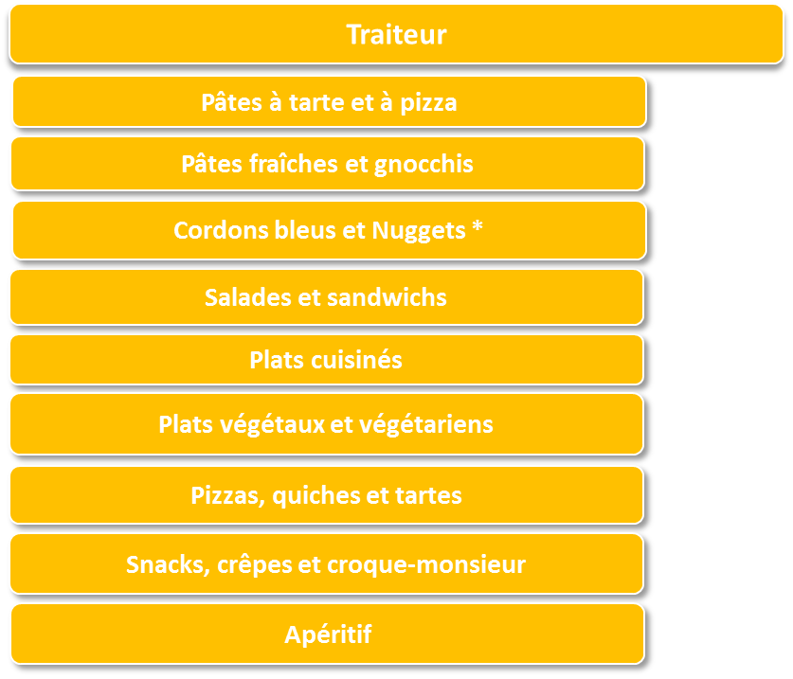
3. Nestlé eMerchandising (very low chance this being requested)
Adding a new screen in the beginning that will feature a list of categories – after clicking on a category, respondents will see the search results for a specified category:
On PC/Tablet on the left we’ll have a list with the same categories
On Smartphone, it’ll be just the orange options
Current estimation: 30 hours (27 July 2018)
Show results for
Pâtes a tarte et a pizza
Pâtes fraîches et gnocchis
Cordons bleus et Nuggets *
Salades et sandwichs
Plats cuisinés
Pats végétaux et végétariens
Pizzas, quiches et tartes
Snacks, crêpes et croque-monsieur
Apéritif

Slide 4
4. Zoom-in option (high chance this being requested)
We need to allow zoom-in on the images inside the enlarged product view. The expectation is to replicate the Amazon zoom-in function, but I would rather keep this as simple as possible. So let me know which is the simplest zoom-in function that can be added. Lightbox pop-up maybe? This is kind of how it works on Amazon for smartphone.

Slide 5
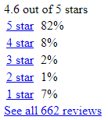
5. Dynamically getting ratings (low chance this being requested)
With this feature the module will be directly getting the real number of ratings and the stars from Amazon. I checked if that’s feasible – and it is. There is a web page that the module can request, that features just this information:
For example: https://www.amazon.com/gp/customer-reviews/widgets/average-customer-review/popover/ref=dpx_acr_pop_?contextId=dpx&asin=B07598VZR8
Where the module only needs to replace the product number in the ASIN link variable ( for each product it’ll be provided inside the module input form)
Here’s the output that needs to be used for displaying the number of ratings and stars inside the module

